Slide 1
EE344: Electronic system design lab P-3: Integration of multiple images in order to construct a 360° wide view. Project supervisor: dr. bidhan pramanick
Team Members:
Jitendra Yadav (180020012)
Sonal Singh (180020026)
Charima Seri (180020005)
Rohitashv Kumar (180020018)
Shubhanshu Tomar (180020023)
Medha Khitoliya (180020014)

Slide 2
OBjectives:
The images from multiple cameras need to be integrated to build a complete 360° view.
This work mainly requires the understanding of Image processing and coding for micro-controller.
Uses:
Can be used as a parking/reverse camera.
An effective security surveillance system/CCTV cameras.
To click 360° street view images for Google maps.
For travelling photography/vlogging.

Slide 3
EQUIPMENTS USED:ent Used:
Raspberry Pi 4 model B 2 gb version.
USB webcams
Breadboard with push button switch
Tripod and platform for cameras.
SD card for storage of raspberry pi.

Slide 4
TechnologIES Used:
OpenCV for stitching the images together.
Shell Script(.sh file) to run commands automatically in raspberry pi terminal.
Used GPIO pins to take input from a push button into the raspberry pi.

Slide 5
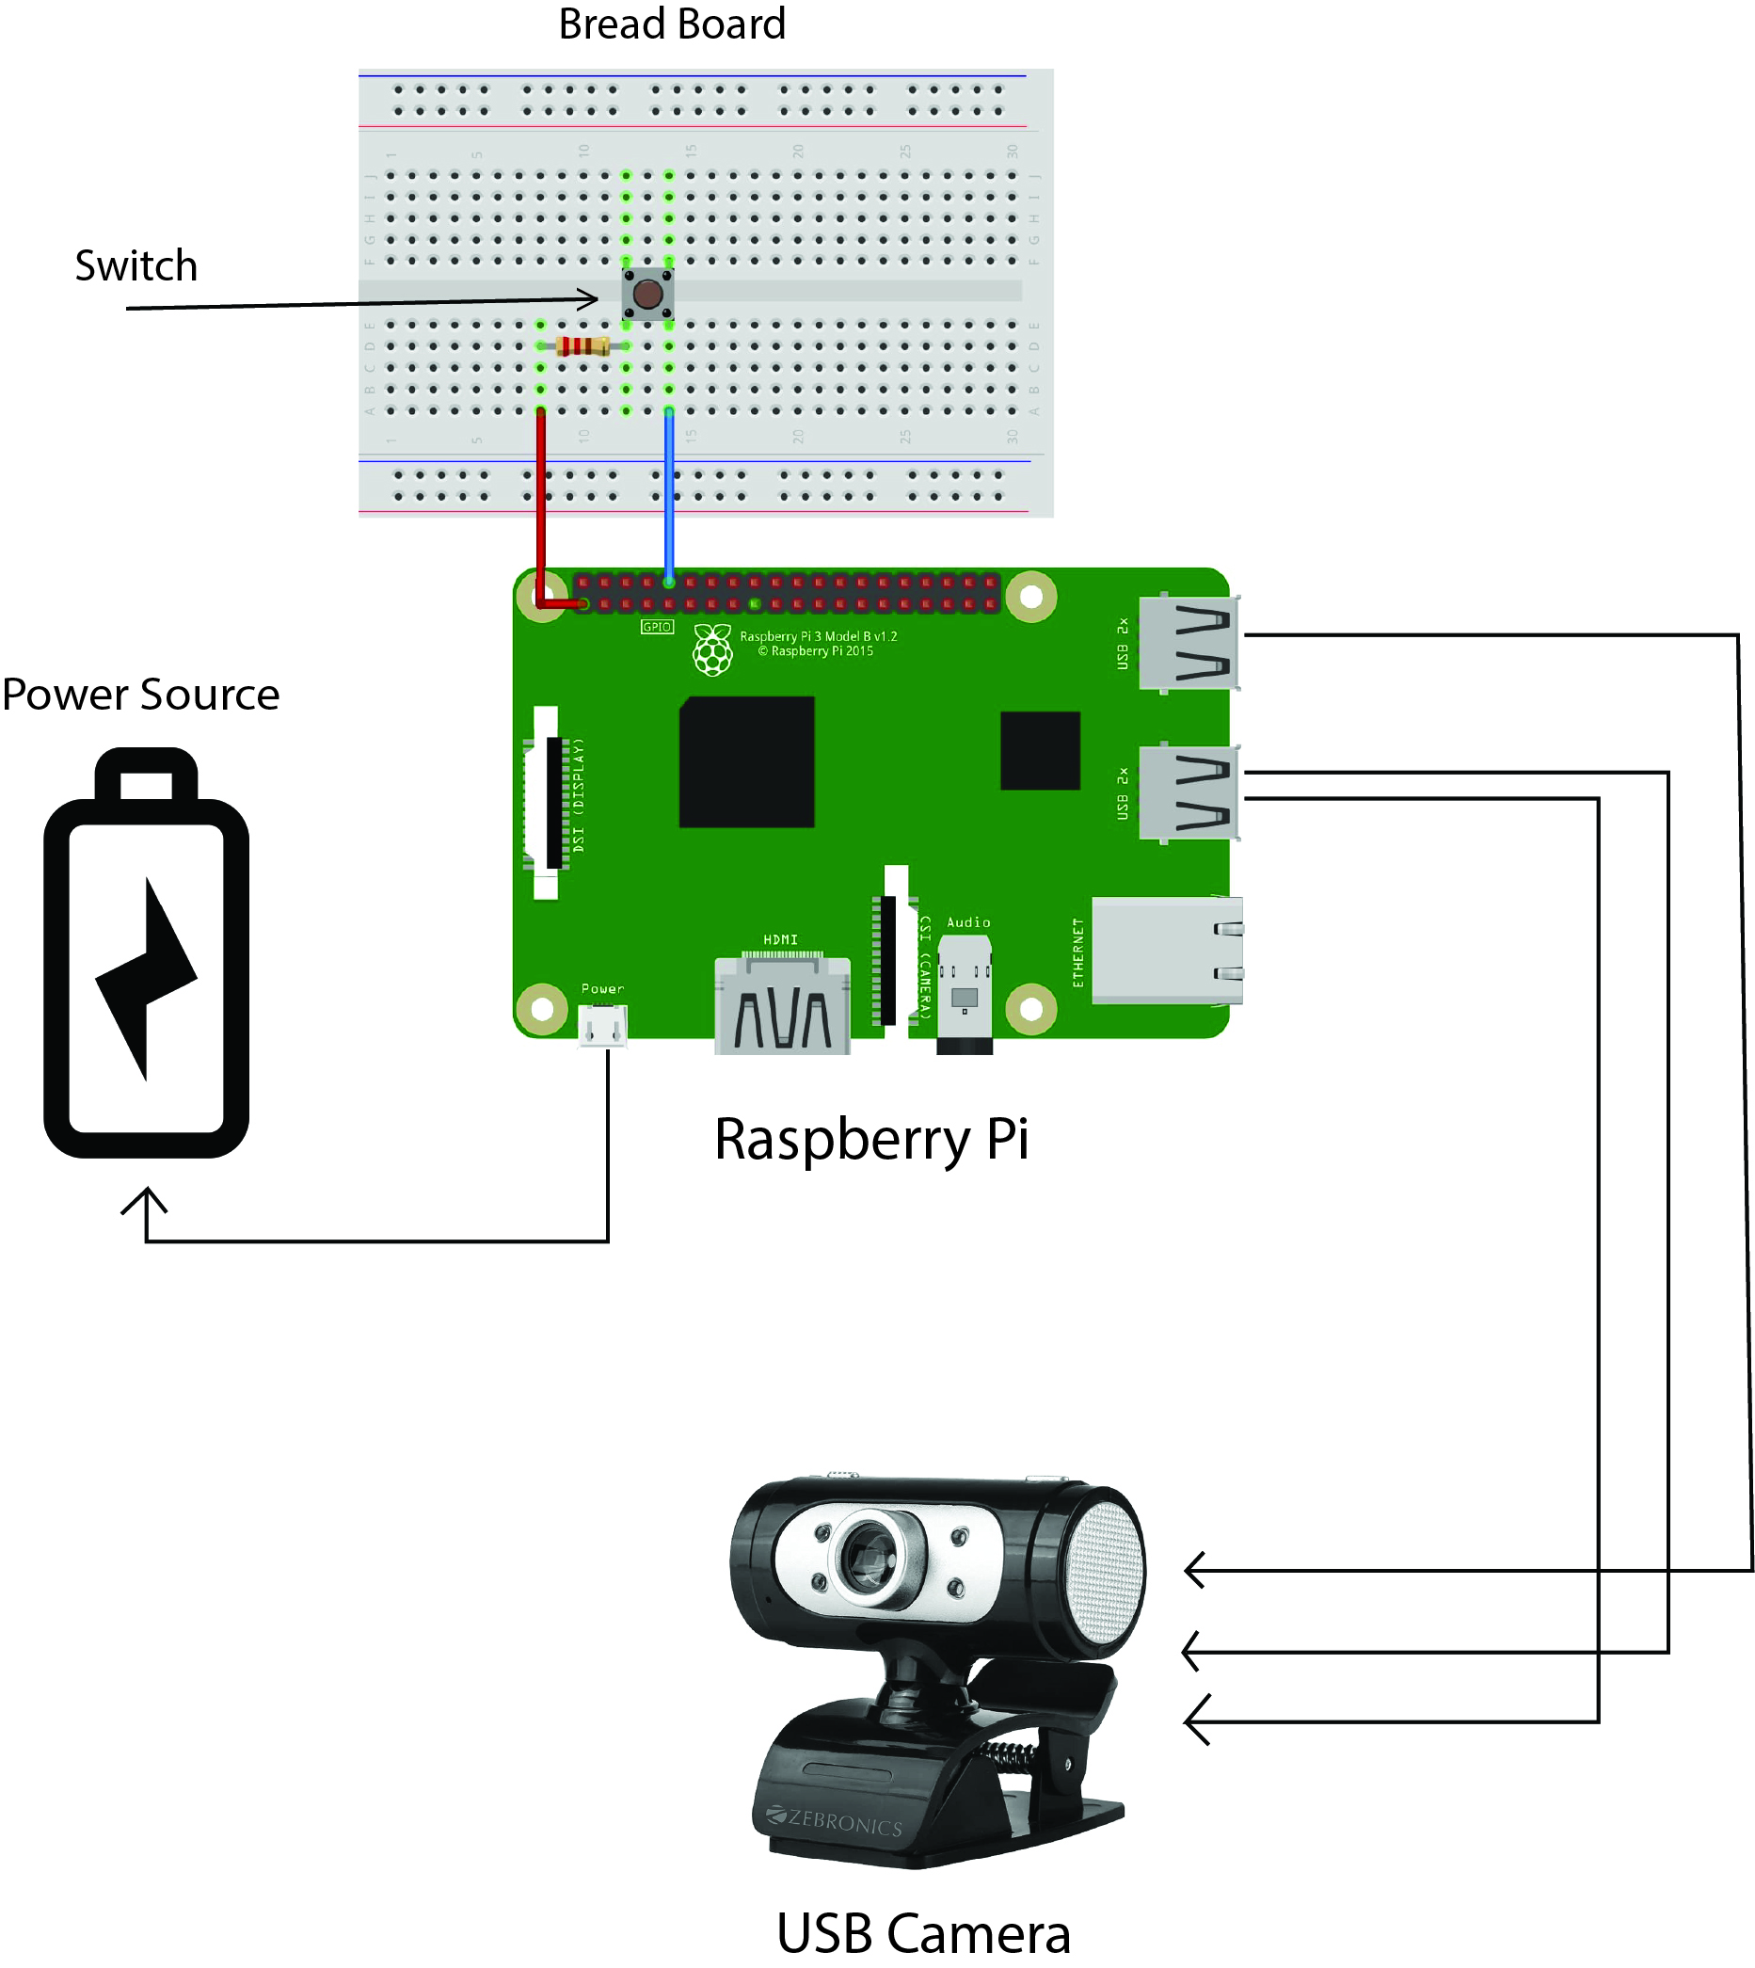
Circuit Diagram:

Slide 6
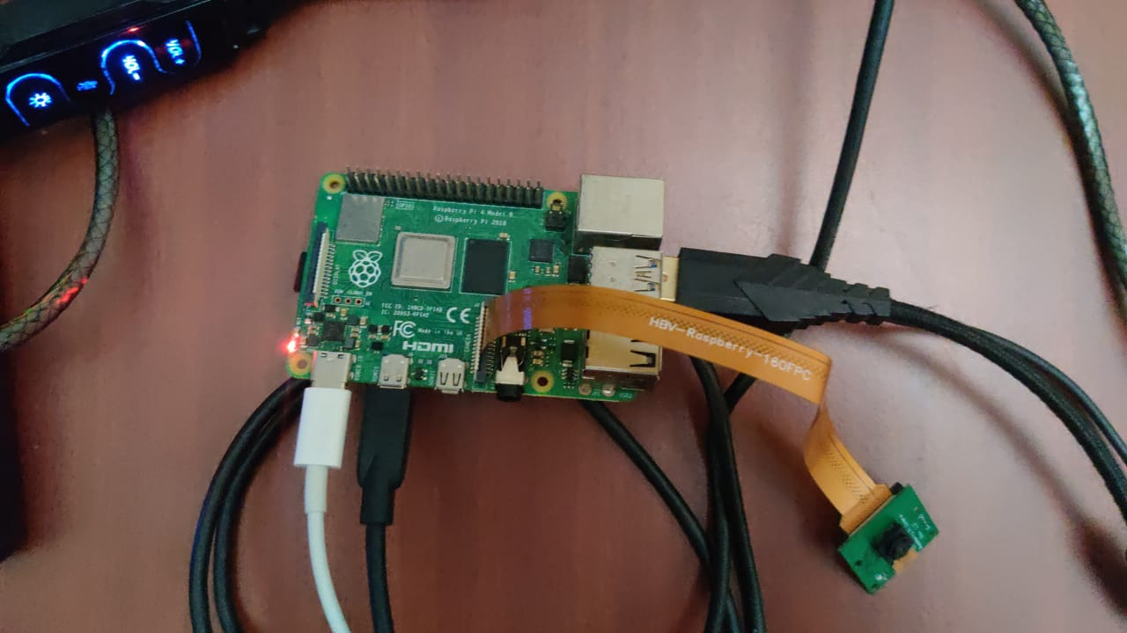
Circuit implementation:ent Used:

Slide 7
Procedure:cedure:
We used multiple cameras, each with a 60 degree angle of view, physically placed such that they cover a 360 degree viewing angle.
When the cameras are triggered with a push button that is implemented on a breadboard connected to the GPIO pins of the raspberry pi, the cameras capture the images which are then sent to the raspberry pi and stored in a folder (input folder).
As soon as the images get stored in the input folder, the code to stitch the images together runs automatically.
The stitching is done using Open CV and IMUTILS libraries. The stitching is performed by firstly identifying the common points/areas among the images and then joining them together by overlapping the common points.
After the raspberry pi stitches the images, the output image is stored in a separate folder (output folder).

Slide 8
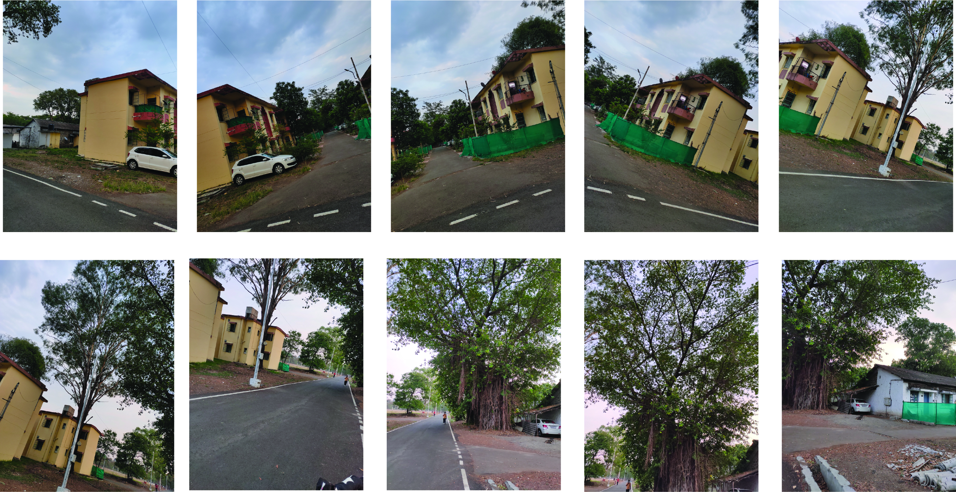
Results:
Input images captured at different angles:cedure:

Slide 9
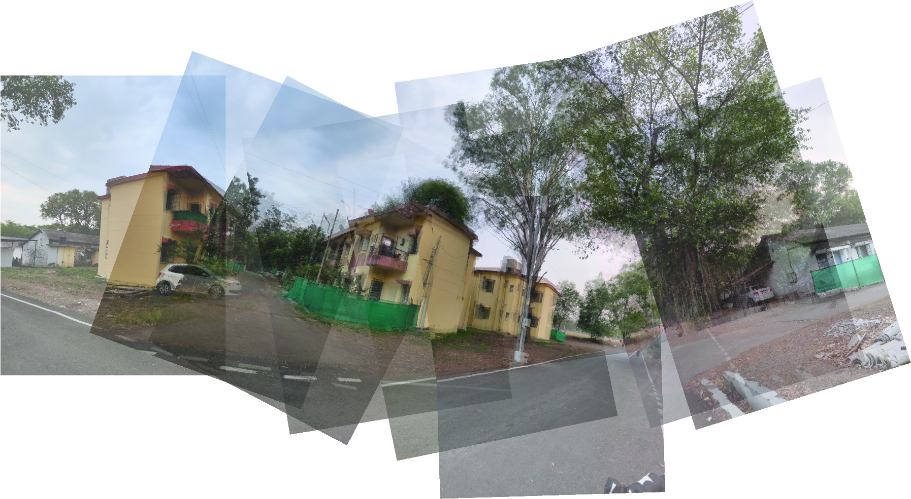
Results:
How the code aligns them together for stitching:cedure:

Slide 10
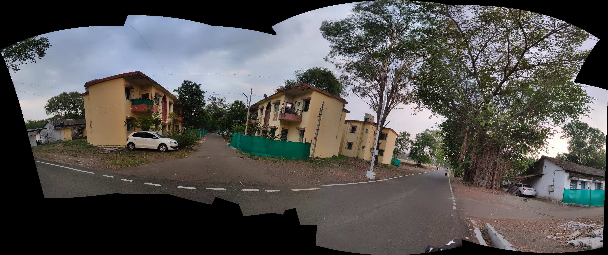
Results:
Processed OUtput image:cedure:

Slide 11
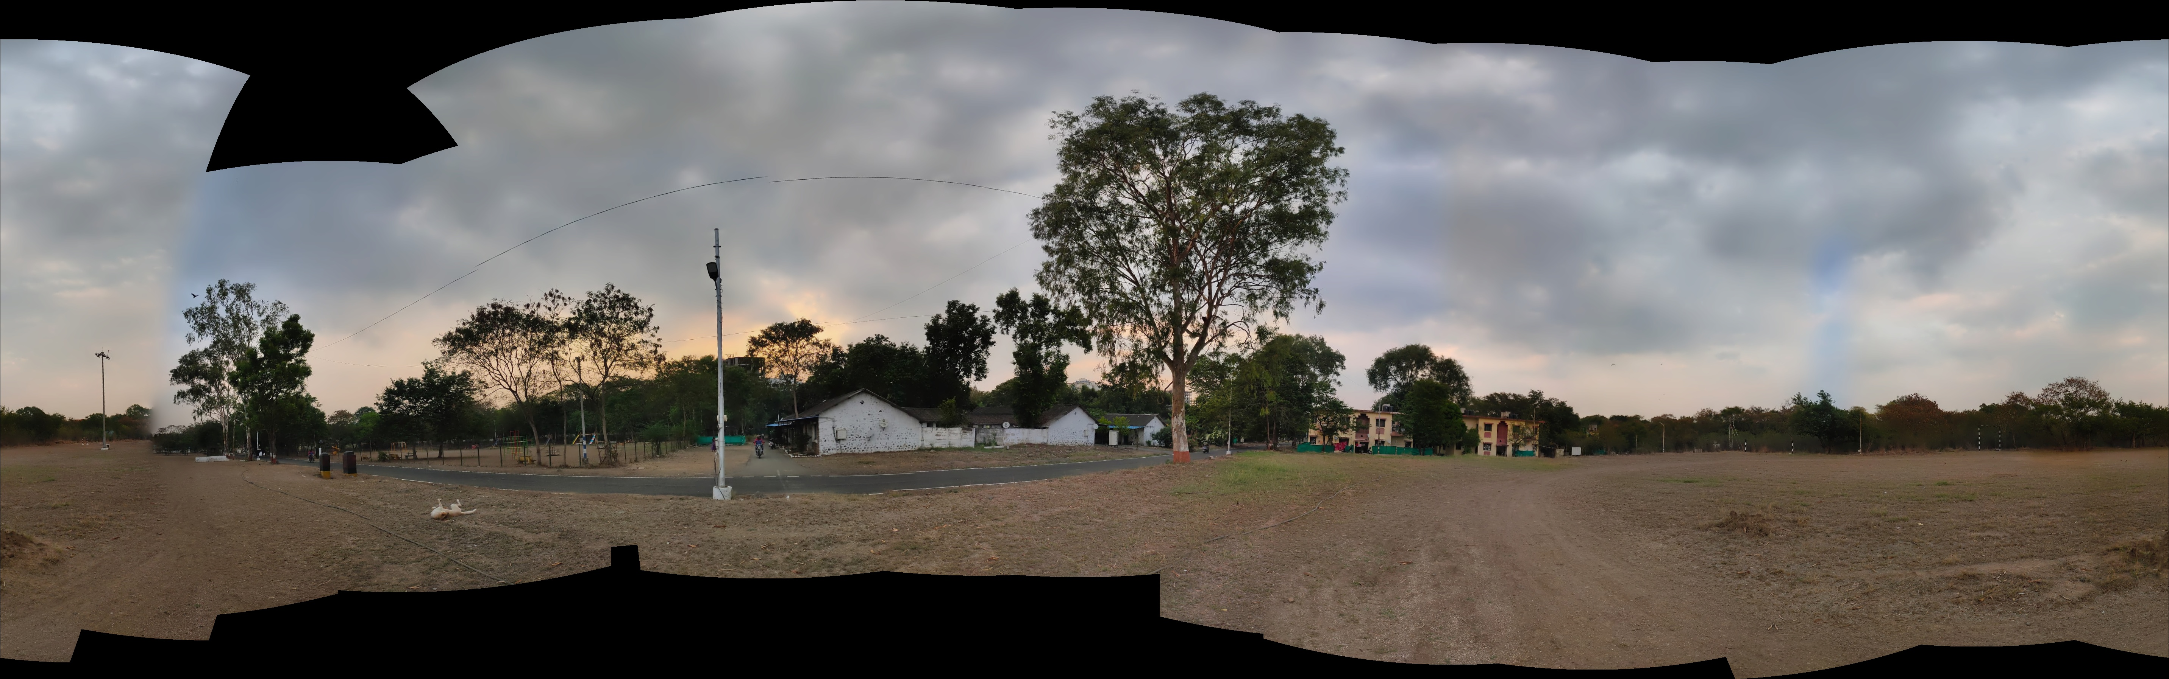
Results:
Processed output image for a 360° view:cedure:
This image was made using 28 input images that covered the entire span of 360°.

Slide 12
FUTURE WORK:
This ia a simple demonstration of the idea, this project can be scaled up for solving some practical real life problems, such as:
Similar to this model, 4 cameras can be used, and the given algorithm can be developed for 360° video stiching, which furthur can be used in security cameras, reverse cameras in car.
In order to bring the cost down of the project, instead of 4 cameras, 1 camera along with a stepper motor can be used, the camera can be rotated to capture images in equal intervals to create multiple images, which can be run on the same algorithm to create a 360° view.

